Slide 1
Learning Circle Simulation Pitch – Business Level Security ScoreCard
November 6th, 2020
Mark Luptak

Slide 2
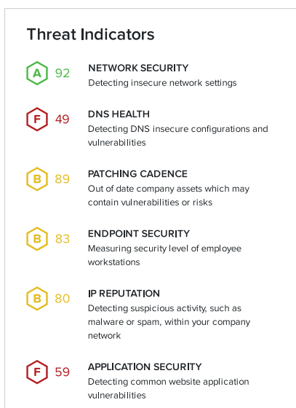
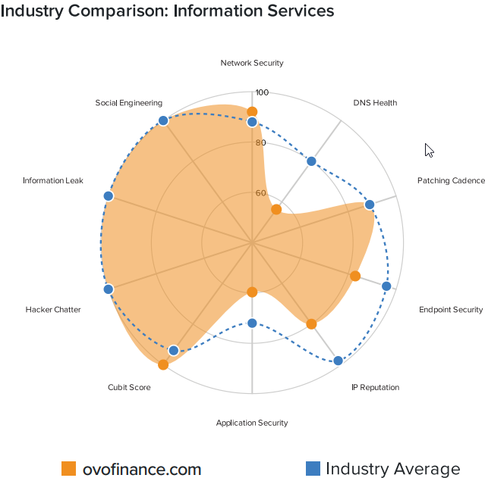
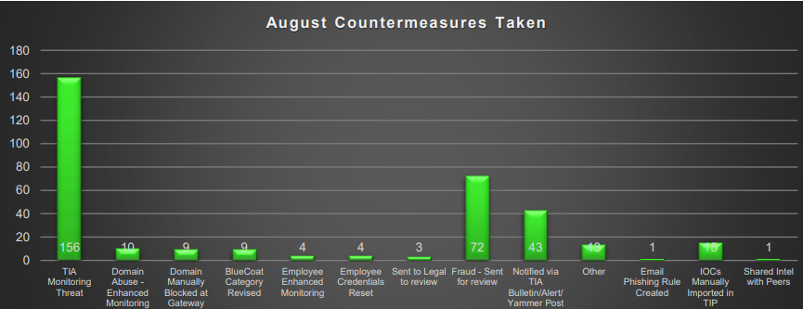
Business Level Security Scorecard
Current and potential clients can receive security scorecards for FIS through multiple vendors. This view, although helpful, will not pinpoint an individual business level security posture.
By incorporating a business level security scorecard we can provide detailed data representing how well our current security posture stands up to the industry standard for each line of business.
For prospective clients this gesture will show how confident and serious we are about security and can help drive new customers to FIS from heavily attacked industries.
Existing clients can track the business score to ensure we are exceeding their security expectations.
Internally these scorecards will quickly identify where we are failing our clients and potential gaps that could drive clients away from FIS.
Improving our security scorecard will reduce our overall threat landscape minimizing potential and actual threats which improves our marketability across new and existing industries.

